Slide 1
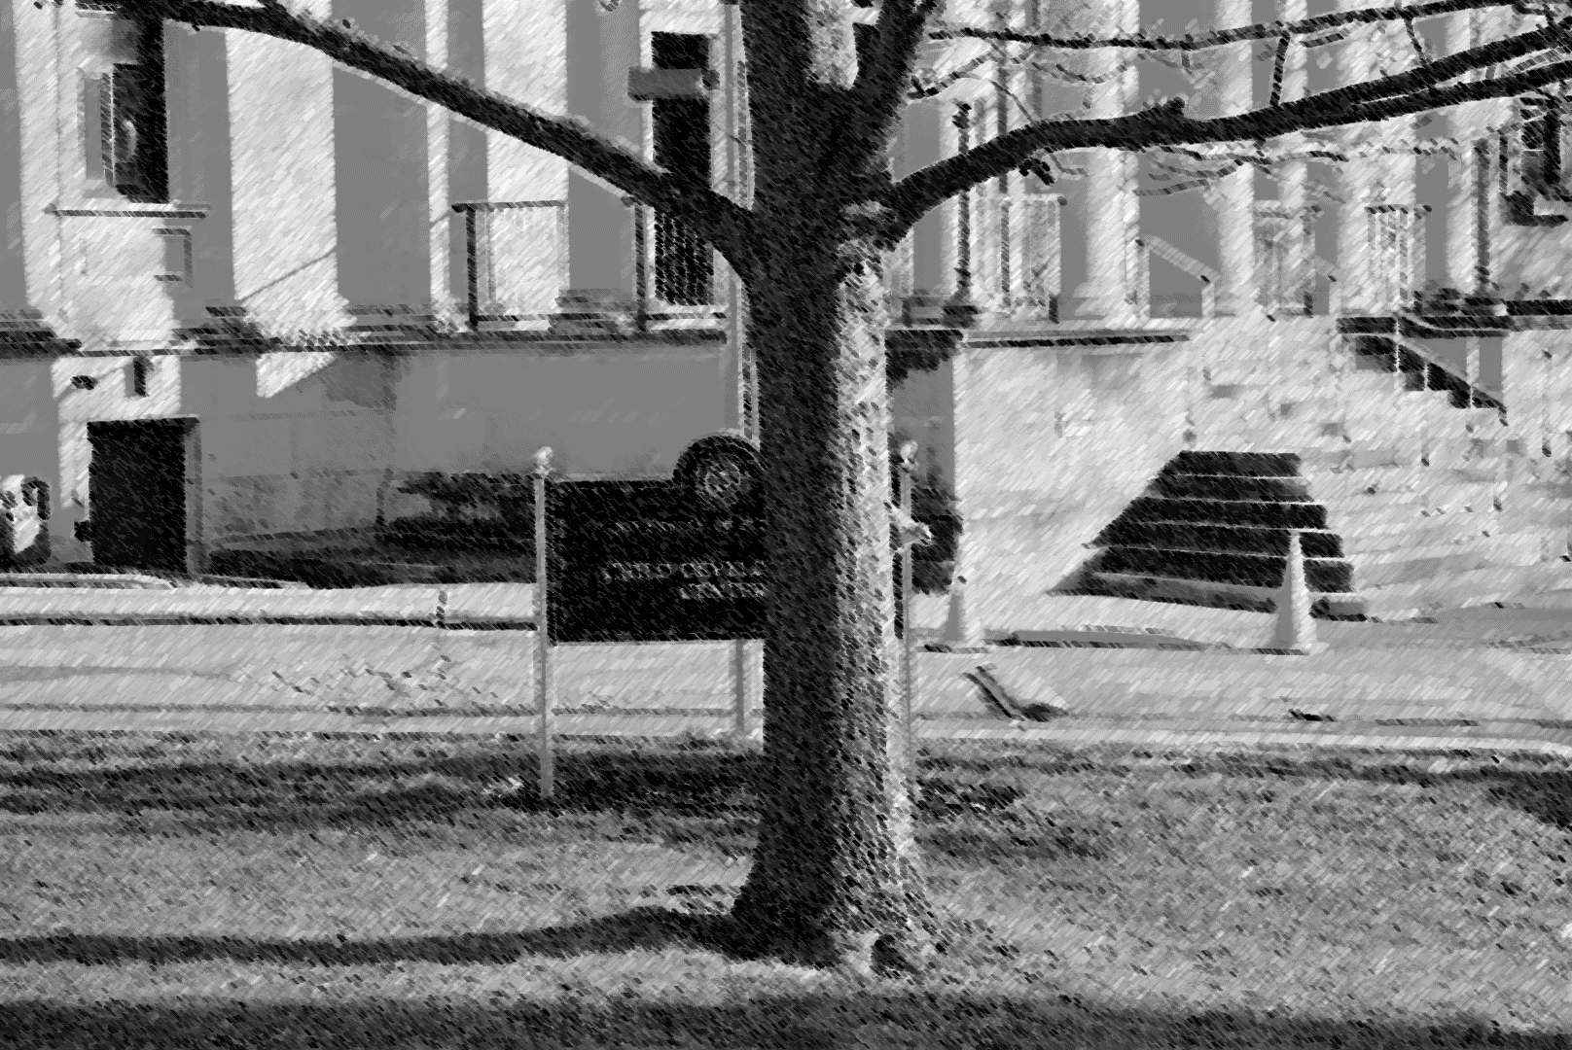
Building a Bw-Tree Takes More than Just Buzz Words
Ziqi Wang¹, Andrew Pavlo¹, Hyeontaek Lim¹, Viktor Leis²
Huanchen Zhang¹, Michael Kaminsky³, David G. Andersen¹
¹Carnegie Mellon University, ²Technische Universität München,
³Intel Labs

Slide 2
The Bw-Tree: Microsoft’s Lock-Free B+Tree
Originally proposed by Microsoft Research
Published in ICDE’13
Integrated into SQL Server Hekaton
2x – 5x faster than Skiplist claimed by the paper
Key components
Mapping table
Delta chain
Compare-and-Swap
Notes:
Add: Animation to illustrate how BwTree update works
Add: Motivation, background design, etc.
---------
Come up with a use case of the BwTree compared with B+Tree
Shorten the first slide (The goal of the talk)
Clear end-to-end message
Fix titles with meaningful points

Slide 3
Delta Update in Bw-Tree
Inner
#101
Δinsert K₀
Delta chain
Leaf
#102
Leaf
#104
K₁
K₄
K₅
K₆
K₇
V₁
V₄
V₅
V₆
V₇
Base Node
Delta Node
Physical Pointer
Notes:
At the beginning of the talk, we first of all have a brief overview of bwtree’s delta update mechanism
It is an over simplified example of BwTree
Two types of nodes: base and delta
Worker threads replay the delta

Slide 4
Delta Update in Bw-Tree
Inner
#101
CAS old -> new
Δinsert K₈
Δinsert K₀
Delta chain
Leaf
#102
Leaf
#104
K₁
K₄
K₅
K₆
K₇
V₁
V₄
V₅
V₆
V₇
Base Node
Delta Node
Physical Pointer
Notes:
Worker threads are serialized by CAS instruction

Slide 5
Delta Update in Bw-Tree
Inner
#101
Δinsert K₈
Inconsistent!
Δinsert K₀
Delta chain
Leaf
#102
Leaf
#104
K₁
K₄
K₅
K₆
K₇
V₁
V₄
V₅
V₆
V₇
Base Node
Delta Node
Physical Pointer

Slide 6
Delta Update in Bw-Tree (w/ Mapping Table)
Inner
#101
ID
ADDR
101
102
103
Δinsert K₀
Delta chain
104
Leaf
#102
Leaf
#104
K₁
K₄
K₅
K₆
K₇
V₁
V₄
V₅
V₆
V₇
Base Node
Delta Node
Physical Pointer
Logical Pointer
Notes:
The Microsoft introduced the mapping table………. (not “WE”)

Slide 7
Delta Update in Bw-Tree (w/ Mapping Table)
Inner
#101
ID
ADDR
101
102
Δinsert K₈
CAS old -> new
103
Δinsert K₀
Delta chain
104
Leaf
#102
Leaf
#104
K₁
K₄
K₅
K₆
K₇
V₁
V₄
V₅
V₆
V₇
Base Node
Delta Node
Physical Pointer
Logical Pointer
Notes:
Mention: mapping table, delta chain and CAS can all cause slow down
None of these three will make it faster for sure. Now the only remaining question is whether they cause slow down
Bigger font

Slide 8
OpenBw-Tree at Carnegie Mellon
First version based on Microsoft paper
No optimization
Poor performance
Second version for Peloton DBMS
Developed optimizations to improve performance
Consulted with Bw-Tree developers at Microsoft
https://github.com/wangziqi2013/BwTree
Notes:
Add: Why did we chose it for Peloton
Add: We did judge BwTree about its performance on memory/SSD system
Add: We think we did a good job and reproduced the result

Slide 9
Today’s Talk
Question #1: How does OpenBw-Tree compare with other indices?
Question #2: Does lock-free features in Bw-Tree cause noticeable slowdown?

Slide 10
About Our Paper
First comprehensive study of OpenBw-Tree’s performance
Use OpenBw-Tree to show how lock-free features affect performance
Describes OpenBw-Tree optimizations
Scalable garbage collection
Pre-allocation of delta nodes
Efficient binary search and delta replay
Caveats!
All experiments are in-memory
No logging
Notes:
Add: Optimizations, enhancements, etc. that the paper did not cover (we called MSR and found out that they also did these..)
Add optimizations in short phrases
Adding that MSR people said it was good for SSD but we did not present it here

Slide 11
We Compare OpenBw-Tree Against…
Masstree (MIT, Harvard; Eurosys’12)
Hybrid of Trie & B+Tree
No hot spot non-blocking Skiplist (Univ. Sydney; ICDCS’13)
Uses background thread to grow towers
BTreeOLC, ARTOLC (TUM, DaMoN’16)
OLC = Optimistic Lock Coupling
Combines optimistic locking and lock coupling
Notes:
We are interested to see how OpenbwTree compares with B+Tree, because they have similar structures and identicalparameters

Slide 12
Configuration
10 core Xeon server; 20 hardware threads
Insert-Only
100% insert
YCSB-A
50% read 50% update
YCSB-C
100% read
8 byte integer key/value
Notes:
Make time shorter on this slide
Do not mention Zipfian multiple times
Mention we also have VARCHAR and email workload, but did not show them in the talk. We observe similar trends for VARCHAR and email

Slide 13
Insert Only Benchmark
20 threads; 50 Million random key
Higher is better
4.5x
1.8x
1.0x
0.81x
0.25x

Slide 14
Read Update Benchmark
20 threads; 50 Million Zipfian key; 50% read 50% update
Higher is better
3.2x
1.9x
1.7x
1.0x
0.11x
Notes:
ART is good because: (1) partial ordering (2) Only stores the partial key and relies on a full key comparison
Do not mention it only in conclusion

Slide 15
Why OpenBw-Tree Inserts Faster than BTreeOLC?
20 threads; 50 Million random key; Insert-Only
Lower is better

Slide 16
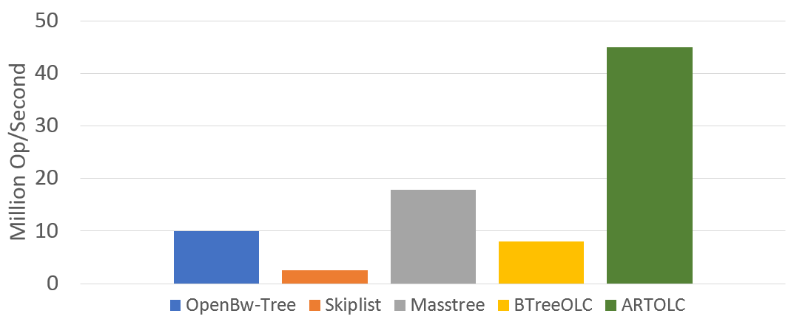
Why OpenBw-Tree Inserts Faster than BTreeOLC?
20 threads; 50 Million random key; Insert-Only add a border around it
Lower is better
50M Insert-Only Throughput
Notes:
If we put 50 million insert only LLC misses with 50 million insert only throughput, there is an interesting observation. We can find a clear correspondence between LLC misses and throughput. The higher miss numbers are, the lower thoughput it will be.

Slide 17
Why OpenBw-Tree Reads Slower than BTreeOLC?
Single thread; Populated with 50 Million random key; YCSB-C Read Only
Higher is better
2.27
Bookkeeping
overhead
18% ↑
23% ↑
0.02% ↑
Still 13%
slower
Notes:
Add: Higher is better, lower is better
Add: Key type
Add: Hardware configuration
Make B+Tree line longer

Slide 18
Recall the Two Questions…
Question #1: How does OpenBw-Tree compare with other indices?
Answer: It depends!
In general, not as fast as ARTOLC or Masstree
Insert-only performance meets expectation
Question #2: Does lock-free features in Bw-Tree cause noticeable slowdown?
Answer: Yes
Notes:
As a supplement, there has been some extensive studies into the cost of lock-freedom on data structures. The experiments from those papers mainly focused on garbage collection, abort/retry mechanism, and so on. Our result here just extends the list of potential source of slowness.

Slide 19
More Observations
Optimistic Lock Coupling (OLC) is effective in reducing locking overhead on modern architecture
Synchronization using background thread does not work well for large data sets
Writing an Open-BwTree is not easy
10,000 LOC
9 months
Dense and complex code compared with B+Tree

Slide 20
Questions?
ziqiw@cs.cmu.edu
https://www.github.com/wangziqi2013/BwTree/

